Slide 1
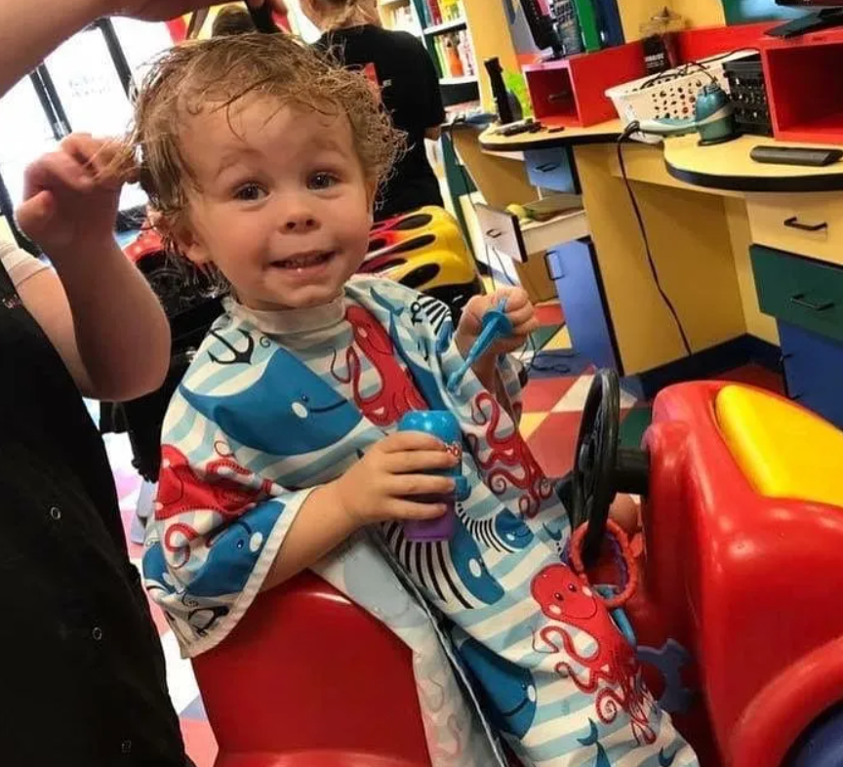
Let’s get a hair cut!
LIKE ALL MY FRIENDS!

Slide 2
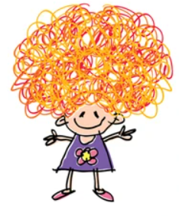
Taking care of my hair keeps it healthy and beautiful, making me feel good too. Sometimes, my hair grows too long and needs a trim to stay fresh. That’s why Mom takes me for haircuts, to keep my hair looking great and feeling nice.

Slide 3
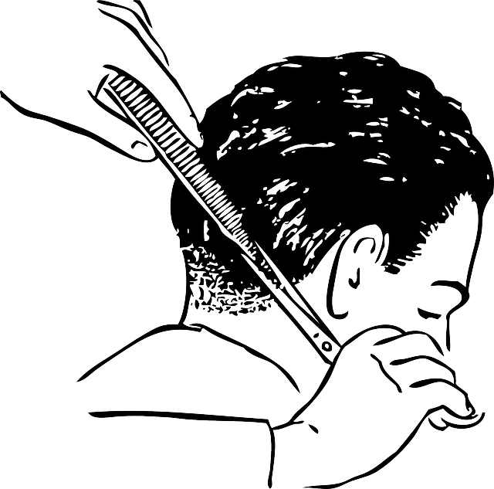
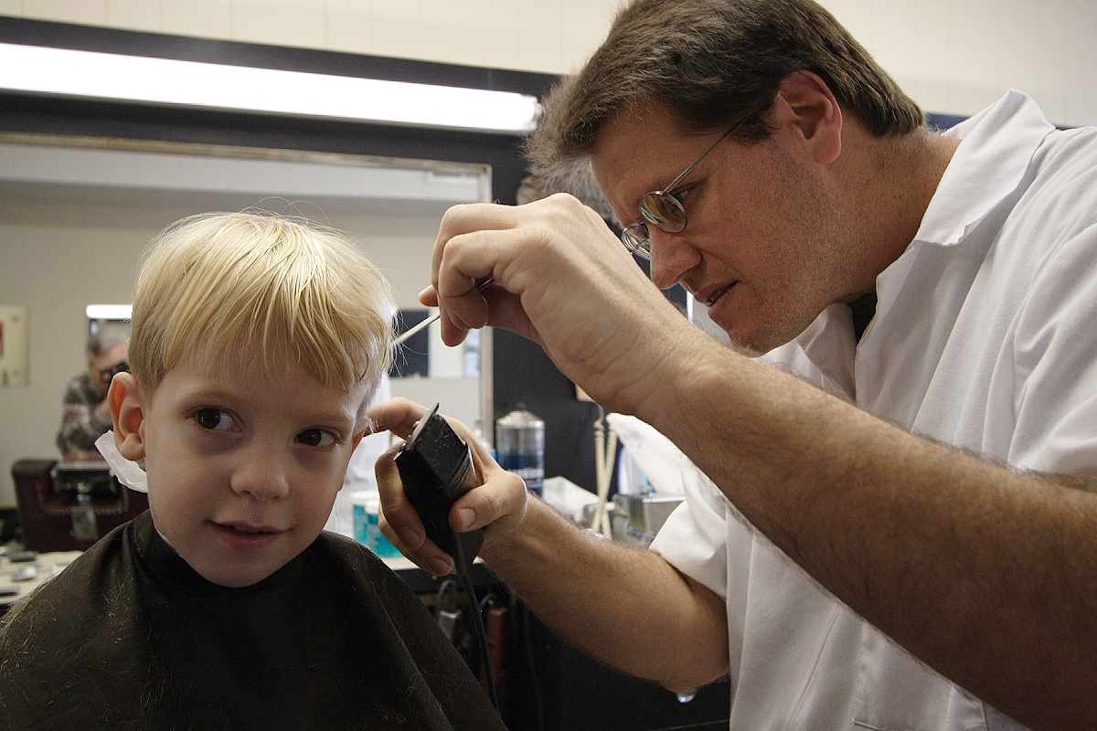
The barber is there to help me with my hair and make sure I look great. Sometimes the clippers can be loud, but that’s okay! I can take breaks. The barber wants me to feel comfortable and happy during my haircut.

Slide 4
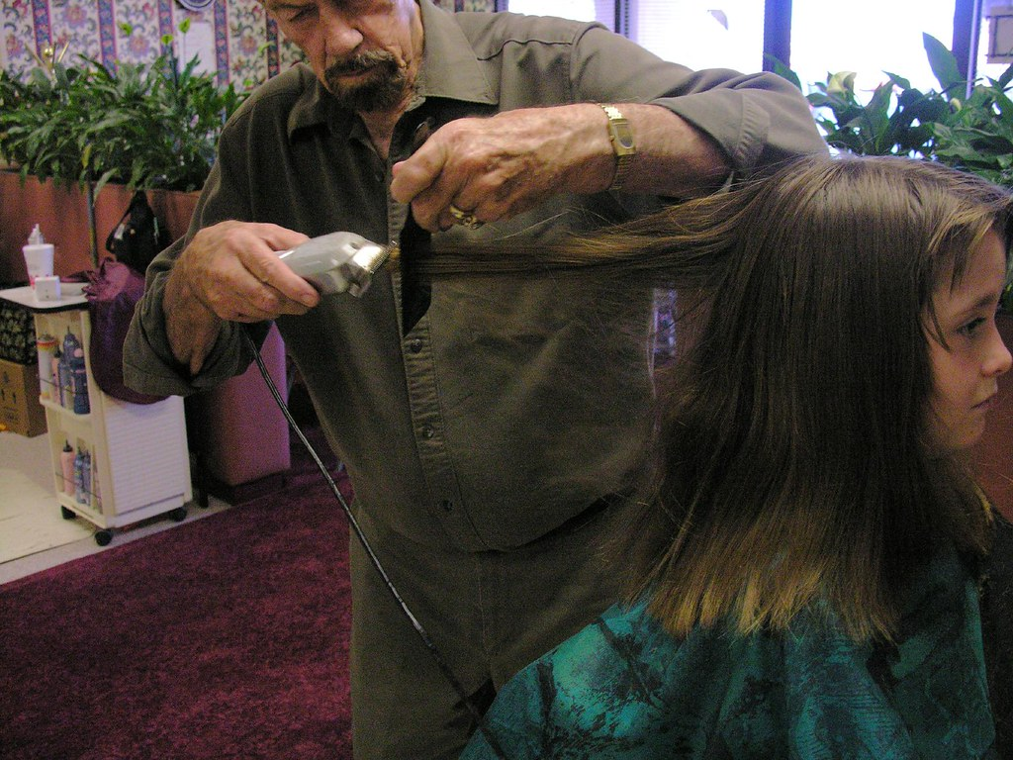
The clippers don’t hurt at all. I can bring my favorite snacks or an iPad while getting my haircut. It will be over soon, and Mom or Dad will be right there with me the whole time.

Slide 5
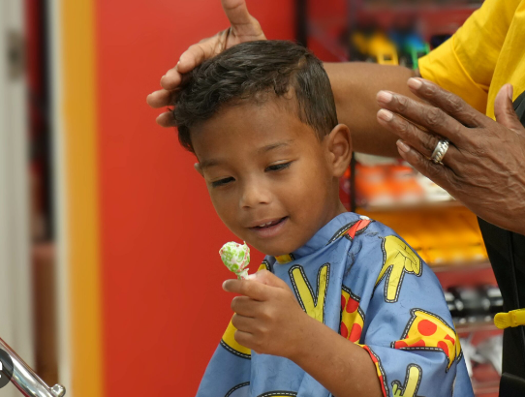
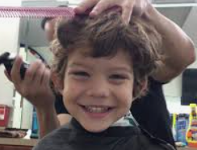
MY friends get haircuts too!
All kids get their hair cut. This makes them look nice!
Getting a haircut is a great way to look handsome (or pretty) and feel good.

