Slide 1
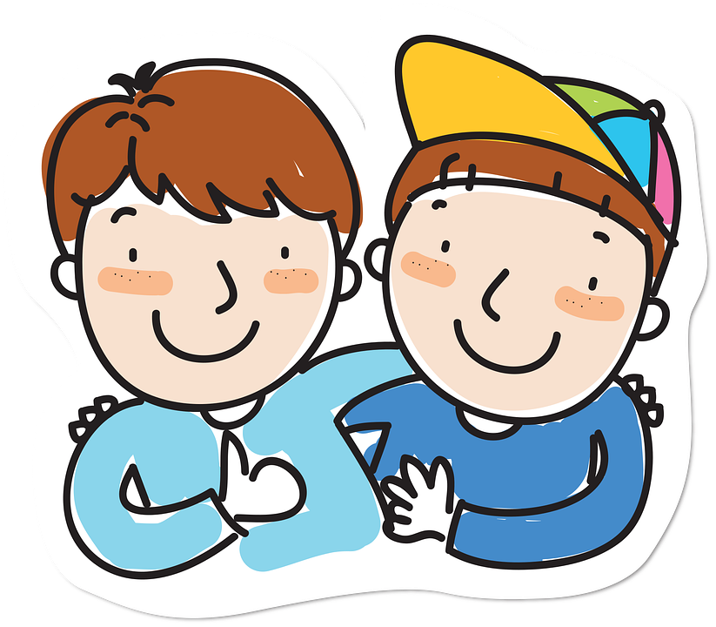
Making a new friend

Slide 2
My name is Frankie. I am going to learn how to make a new friend.

Slide 3
I will say hello and introduce myself. I can say “Hello, my name is Frankie, what is your name?”

Slide 4
I will ask questions and discover things that we both like. I can say “Do you like to play with cars?” or “What do you like to play with?”

Slide 5
I will be kind, share, and listen.

Slide 6
It’s okay to feel nervous, take deep breaths and smile.

Slide 7
Stay in touch and be a good friend.

