Slide 1
My First Trip to Disney!

Slide 2
My name is Janae. I am going to Disney World for the first time with my family.

Slide 3
We’re going on a road trip! There’s many things I can do in the car.
I can bring sensory toys, puzzles, books, snacks, or my iPad on the ride.
I can tell Mommy or Daddy if I need a potty break.
I can also take a nap if I feel tired.
Notes:
You can pick either the flight or the road trip to fit which one is best for your trip.

Slide 4
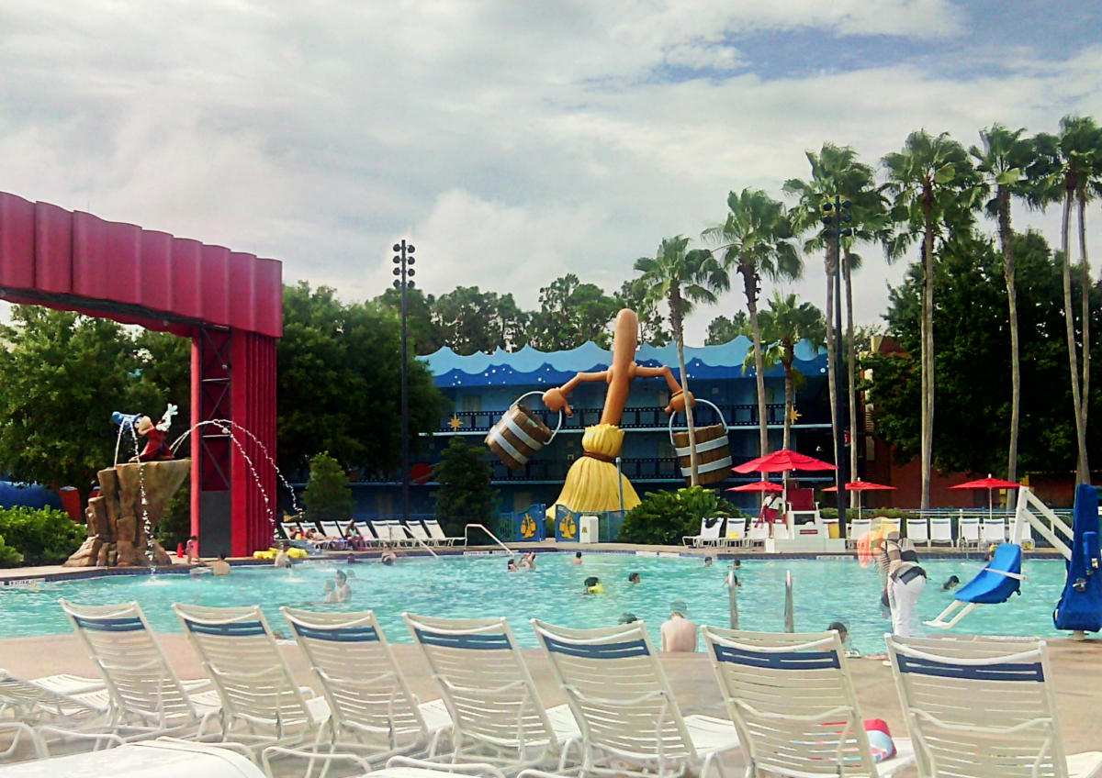
We will stay in a nice hotel. This will be our home for the trip. We will sleep and shower here, and we can go to the pool when we want a break from the parks.

Slide 5
There are so many fun things to do at the park! We will go on fun rides and see my favorite Disney characters.
I can take pictures with the characters if I want!
I can ask the characters for a high five or wave and say hi!
It’s okay if I’m scared, I don’t have to get close.

Slide 6
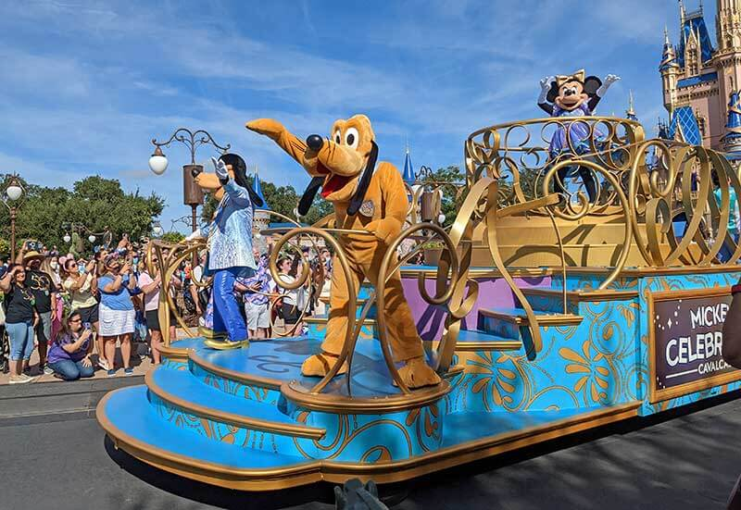
There will be parades full of characters to see! It can get crowded, but that’s okay.
There will be lots of people watching the parade.
I will see big floats, people dancing and singing, and hear loud music.
It will be so beautiful to see!
If I need a break, I can tell Mom or Dad and we can find a safe, quiet place.

Slide 7
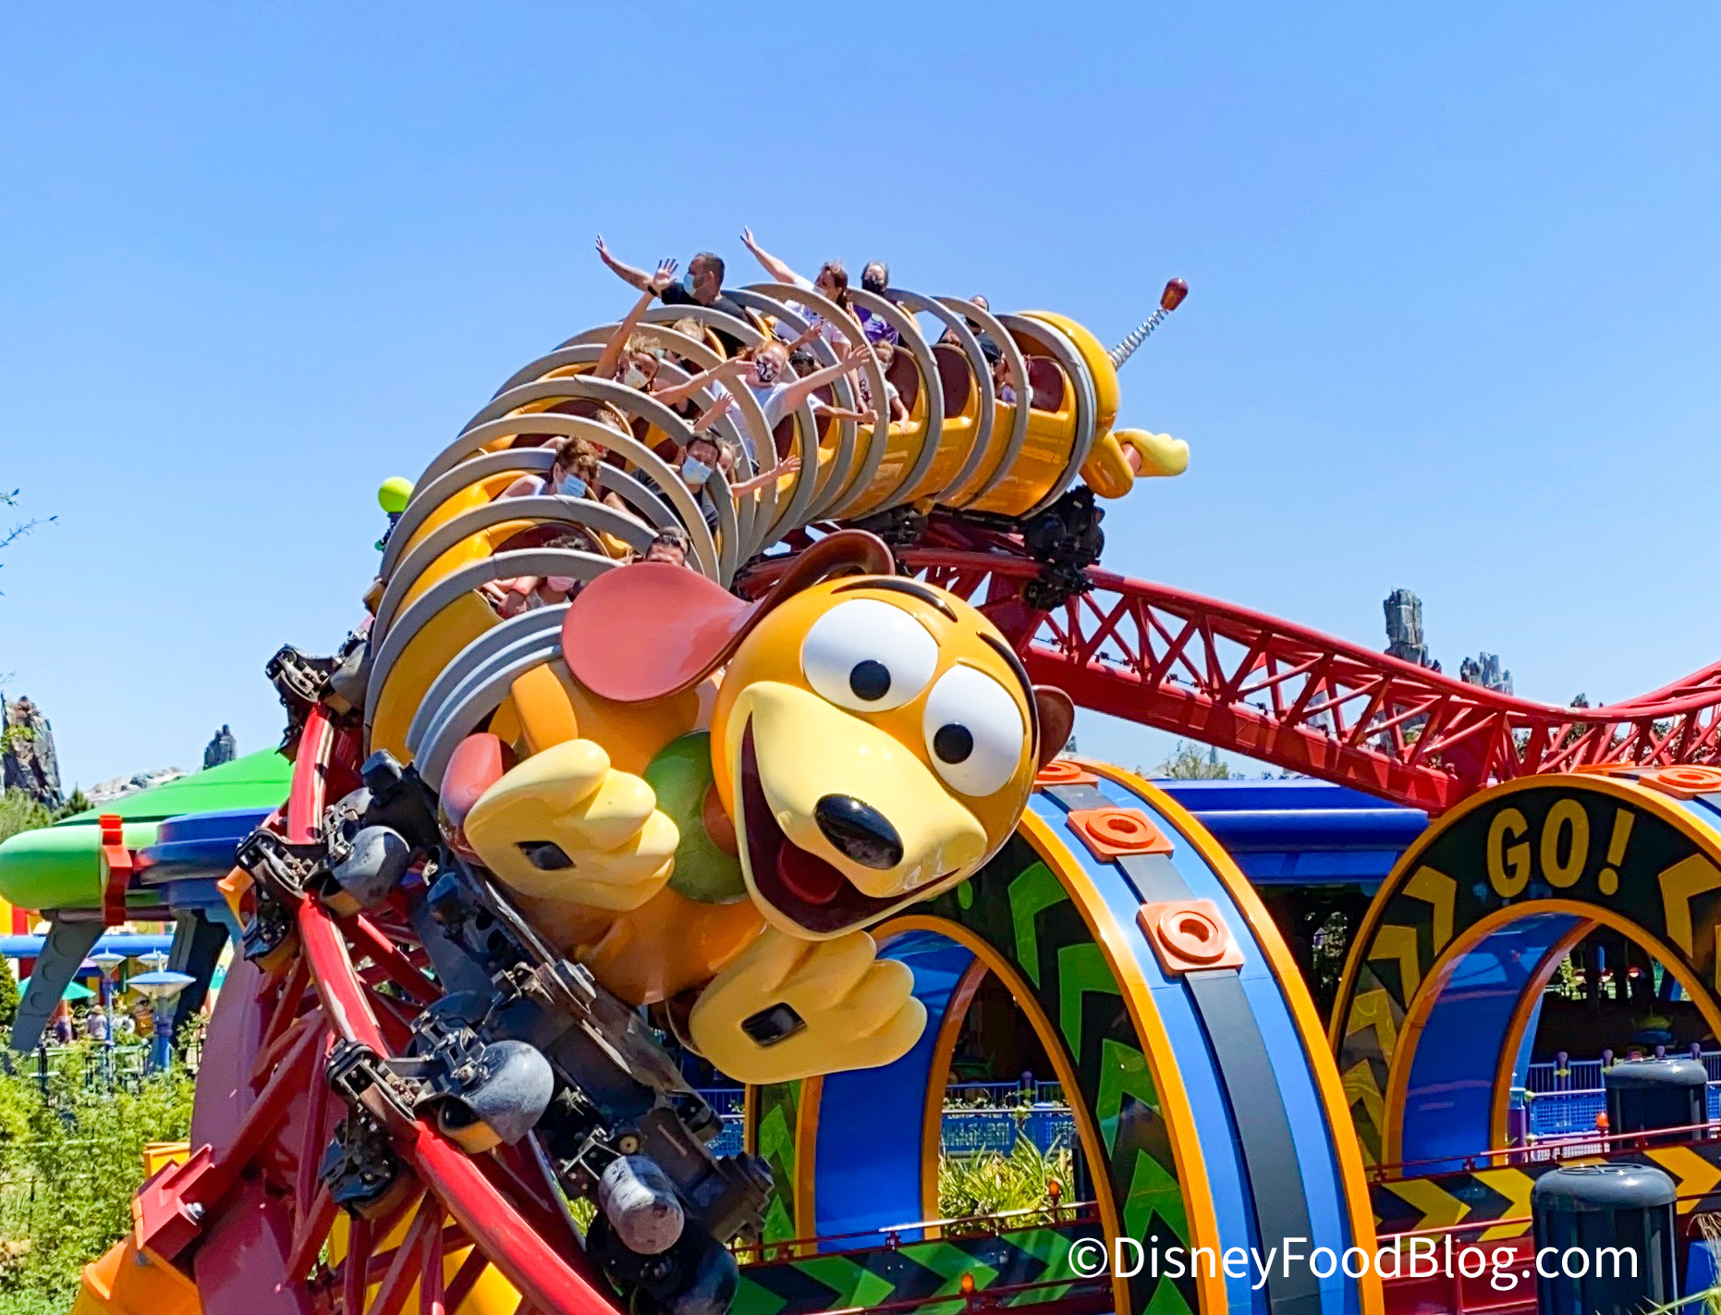
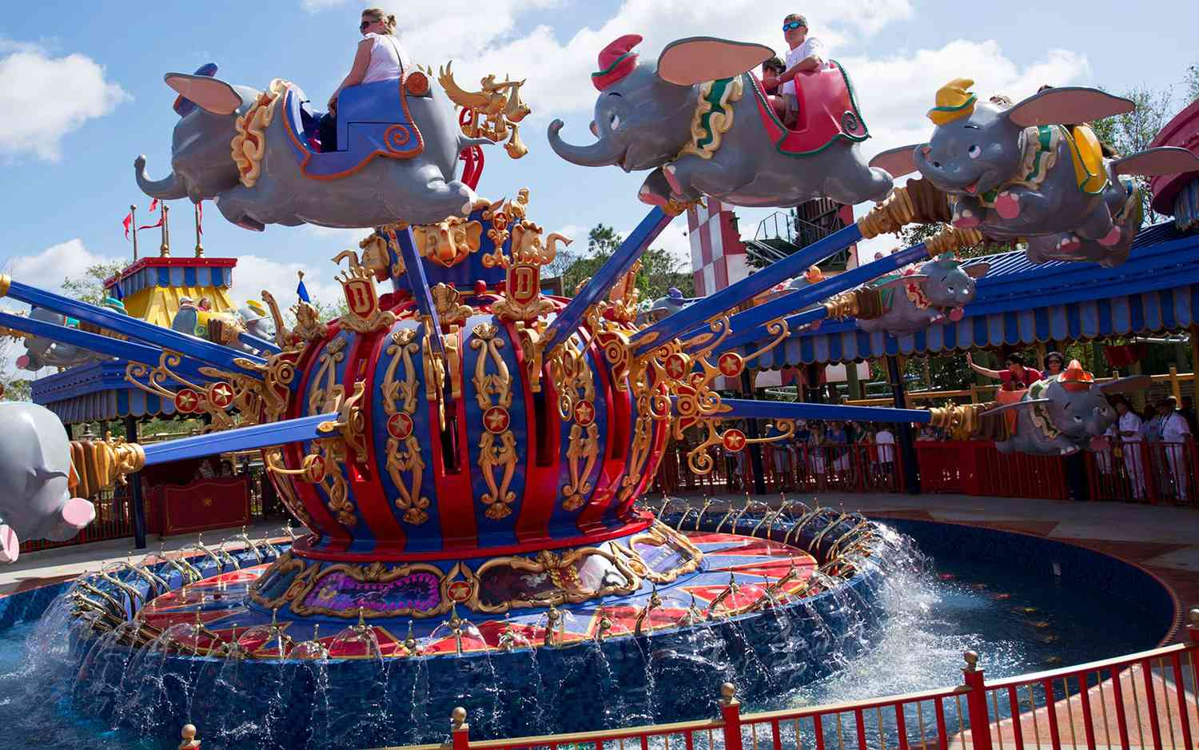
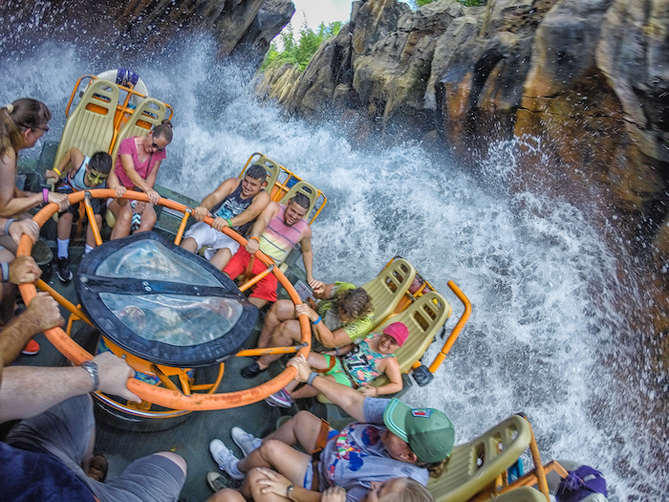
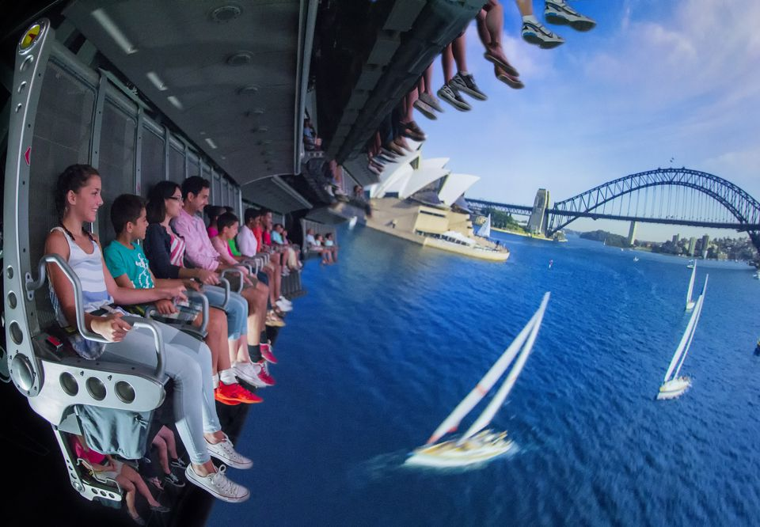
On the rides, there will be lots of movement, lights, and loud noises.
It’s okay to feel scared or nervous. I can cover my eyes or ears. Mommy and Daddy will be right next to me to help.
I can try new things! I will have lots of fun!

Slide 8
There’s so many treats at Disney World! I can try new food, or I can bring my own snacks to the park.

Slide 9
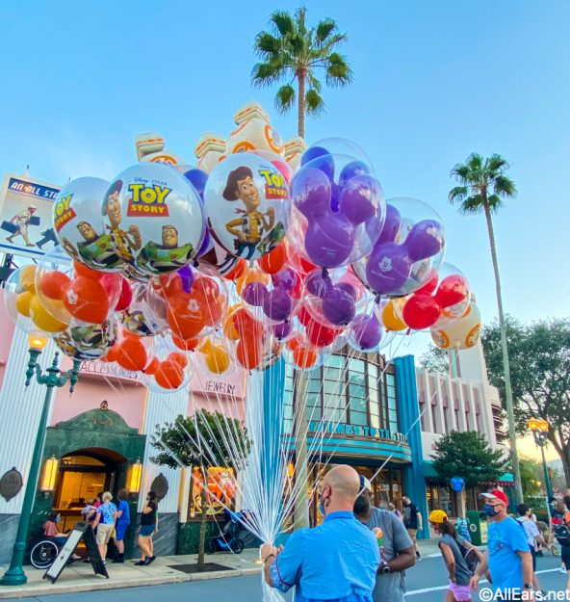
There’s many cool toys and balloons at the park!
It’s important to stay with Mom and Dad so that I stay safe.
I can ask for things that I want, and it’s okay if Mommy and Daddy say no. Maybe next time.

Slide 10
At the end of the night, they have a fireworks show! There’s so many beautiful colors and music.
I will be in a big crowd again. That’s okay, I will be with Mom and Dad!
I can cover my ears or wear headphones to help with the loud noises.
The show will be so much fun to see!
If I feel tired, it’s okay to tell Mom and Dad I want to leave.

Slide 11
My first trip to Disney is going to be so much fun! There’s many new things to see and I can have fun while being safe!

Slide 12
For parents: Disability Assistant Service (DAS) Pass is available for the trip
DAS Pass will allow you to go on rides without having to wait long lines.
This will aid the trip for you and your family to have a more enjoyable experience and make your kiddo feel comfortable.
To learn more about how to register for the DAS Pass here is the link below:
Disability Access Service (DAS) Pass

